Slide 1
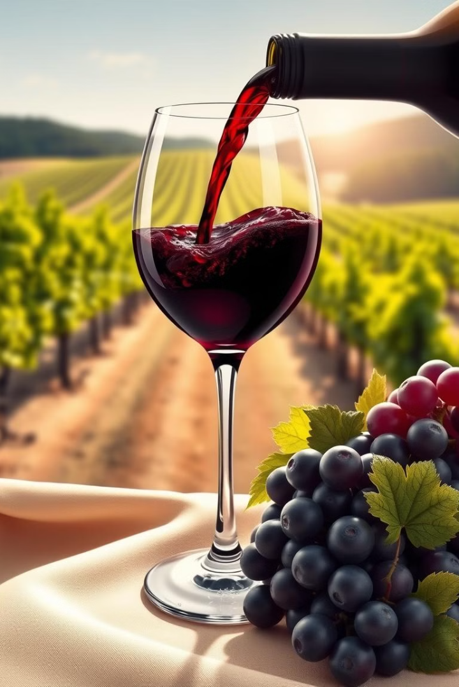
Introduction to Wine Prediction
This presentation explores the fascinating world of wine prediction, unveiling the science behind its flavors, the factors that influence them, and the power of machine learning to enhance the tasting experience.
K
by Vaibhav Gautam

Slide 2
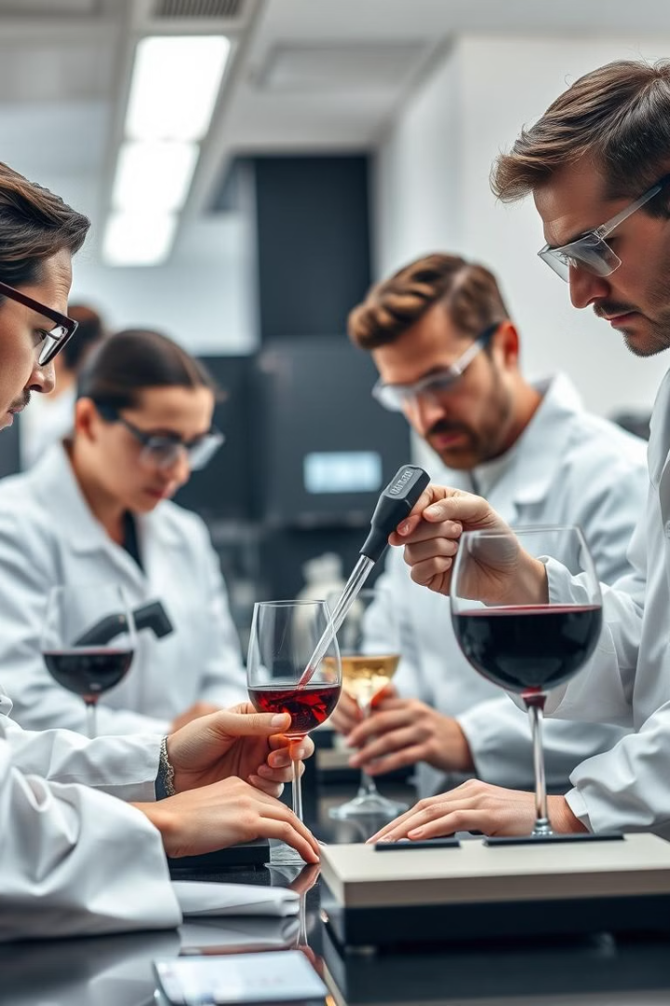
The Science Behind Wine Tasting
1
Visual Inspection
Wine's color, clarity, and viscosity are carefully observed to glean initial clues about its age, grape variety, and quality.
2
Aromatic Analysis
Trained palates identify a diverse range of aromas, from fruity and floral to earthy and smoky, revealing the wine's origin, aging process, and unique character.
3
Palate Evaluation
The taste buds are activated, assessing the wine's sweetness, acidity, tannins, alcohol, and overall balance, providing a comprehensive profile of its sensory qualities.

Slide 3
Factors Influencing Wine Flavor
Climate
Soil
Viticulture Practices
The sun's warmth, rainfall patterns, and temperature variations all impact grape maturity and flavor development.
The composition of the soil influences mineral content and drainage, shaping the wine's acidity, tannins, and overall character.
Vineyard management techniques, such as pruning, irrigation, and disease control, play a significant role in grape quality and wine flavor.

Slide 4
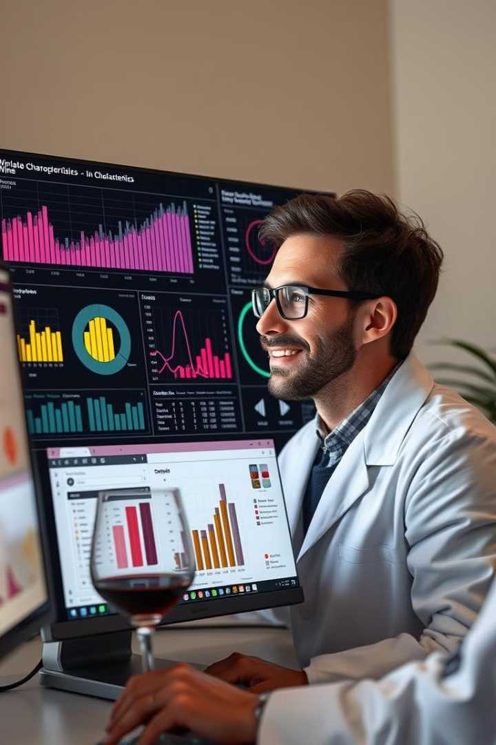
Machine Learning in Wine Analysis
1
Data Collection
2
Model Training
Collecting vast amounts of data on grape varieties, growing conditions, production methods, and sensory evaluations is crucial for training ML models.
ML algorithms analyze the collected data, identifying patterns and relationships between various factors and wine characteristics, enabling prediction.
3
Predictive Analysis
4
Continuous Learning
Once trained, the ML model can predict specific characteristics, such as acidity, tannins, or sweetness, based on new input data, aiding in winemaking and tasting.
ML models can adapt and improve their predictions over time as new data is collected and analyzed, refining their understanding of the complex world of wine.

Slide 5
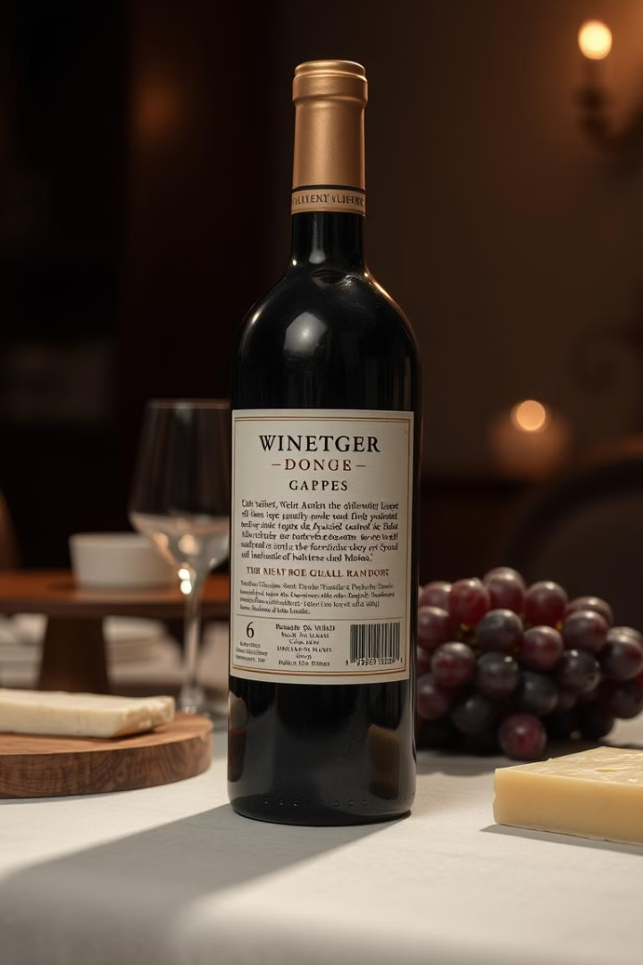
Predicting Wine Characteristics
Acidity
Predicting the tartness and freshness of the wine, crucial for balance and food pairing.
Tannins
Estimating the astringency and structure of the wine, influencing mouthfeel and aging potential.
Sweetness
Forecasting the sugar content and residual sweetness, impacting the wine's style and perceived heaviness.
Aroma Profile
Predicting dominant aromas, such as fruity, floral, earthy, or smoky, providing insights into the wine's complexity and origin.

Slide 6
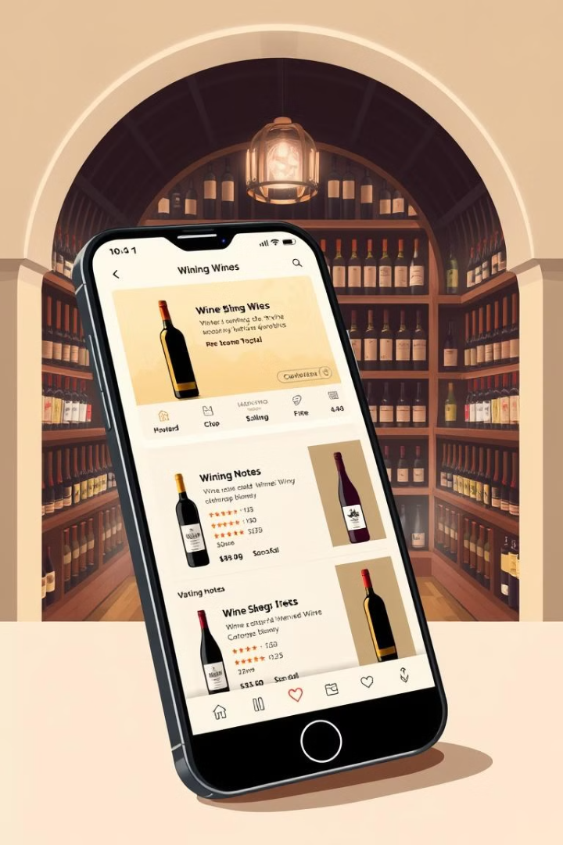




Personalized Wine Recommendations
User Preferences
Taste History
Gathering user preferences for grape varieties, flavor profiles, and food pairings to personalize recommendations.
Analyzing past ratings and reviews to understand individual tastes and refine recommendation algorithms.
Wine Availability
Occasion & Budget
Providing recommendations based on the user's location, taking into account local availability and pricing.
Tailoring recommendations to specific occasions and budget constraints, ensuring an appropriate and enjoyable experience.

Slide 7
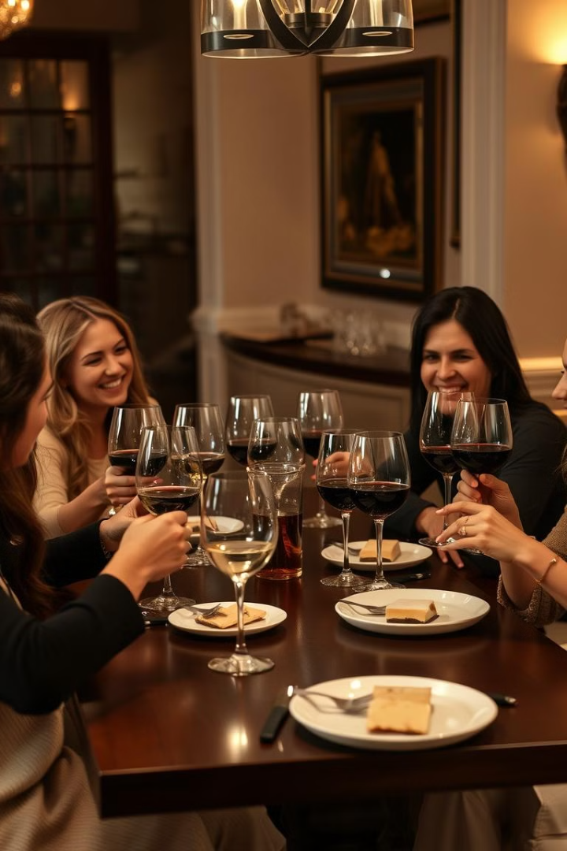
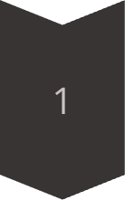
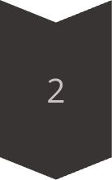
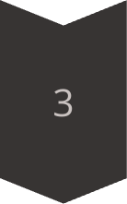
Enhancing the Wine Tasting Experience
Pre-Tasting Information
Providing detailed information about the wine's origin, grape variety, and expected tasting notes, enhancing anticipation.
Guided Exploration
Offering insights on specific aromas and flavors to guide the tasting, fostering a deeper understanding and appreciation.
Food Pairing Suggestions
Recommending complementary food pairings to enhance the wine's flavors and create a harmonious culinary experience.

Slide 8
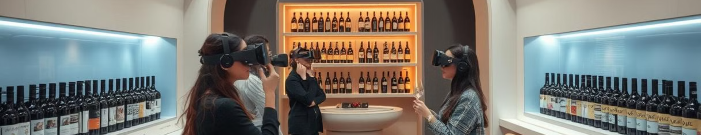
Conclusion and Future Developments
Wine prediction is revolutionizing the wine industry, offering a scientific approach to understanding and appreciating its diverse flavors and nuances. The future holds even more exciting possibilities, including the development of personalized wine experiences powered by artificial intelligence and augmented reality.

